Slide 1

School of Information Technologies and Engineering ENCE3500 Data & Information Engineering 2025 Spring
JOB DATA IN AZERBAIJAN
TEAM 4
Laman Panakhova
Jala Asadli
Mahammad Mammadli

Slide 2

Agenda
Problem Statement
Data Collection
EDA & Preprocessing
Machine Learning Tasks
Results & Visuals
Code Demonstration

Slide 3
Contributions
Team Member | Contribution
Laman Panakhova BSCS 2026 | Web Scraping, EDA, Machine Learning, PPT, README 33%
Jala Asadli BSIT 2026 | Web Scraping, Data Preprocessing, EDA, PPT, README 33%
Mahammad Mammadli BSCS 2027 | Data Preprocessing, Machine Learning, PPT, README 33%

Slide 4
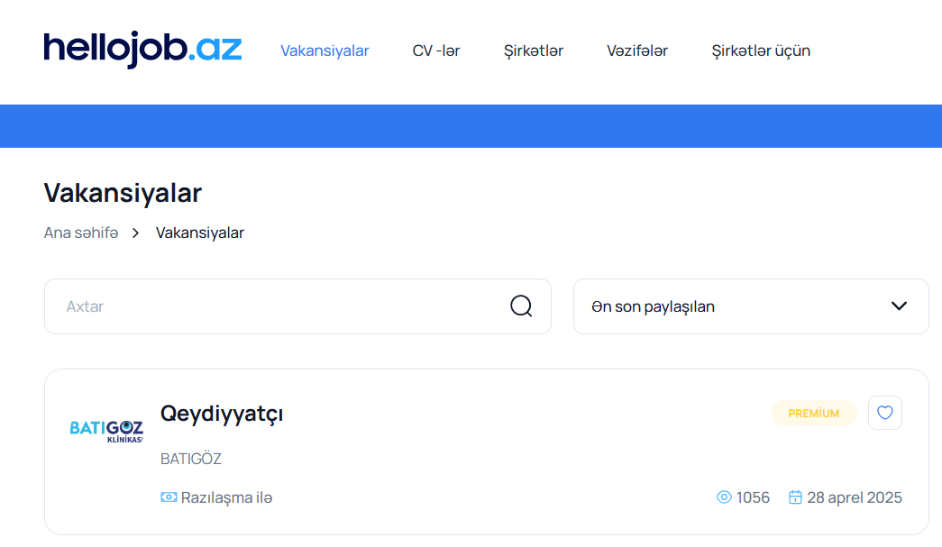
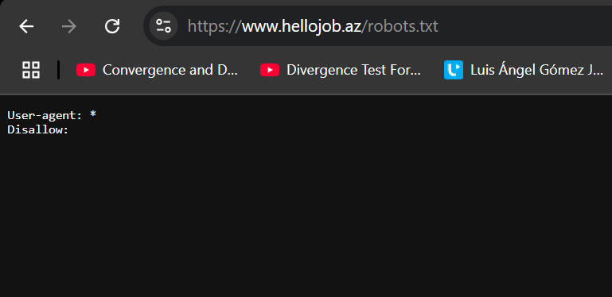
Problem Statement
The website - https://www.hellojob.az/vakansiyalar
Purpose – Collection & Analysis of the Job Data in Azerbaijan

Slide 5
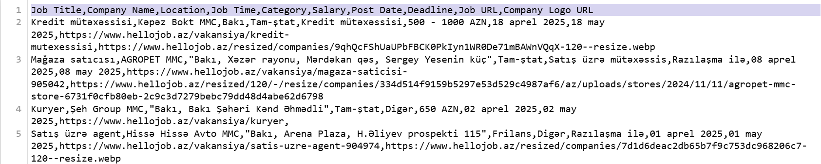
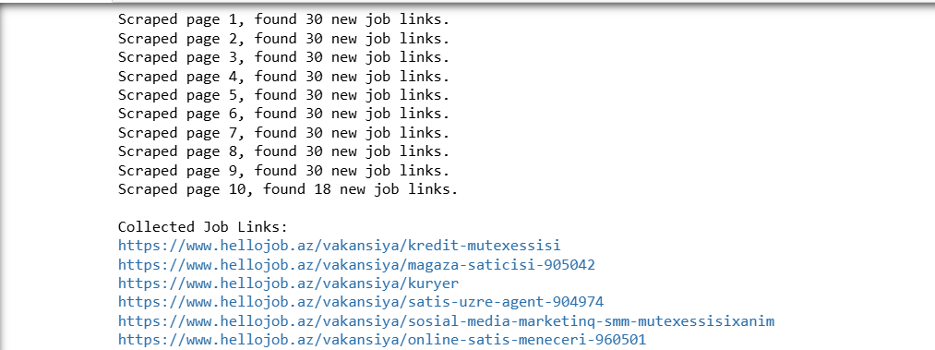
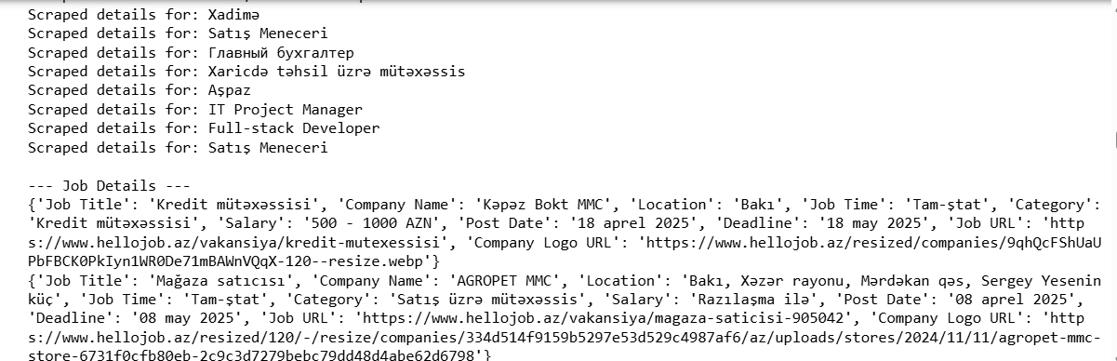
Data Collection

Slide 6
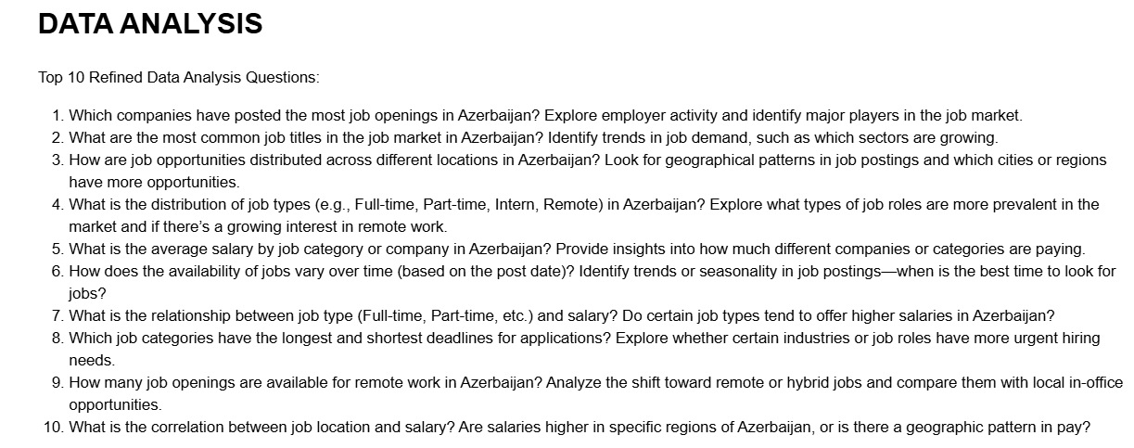
EDA & Preprocessing

Slide 7
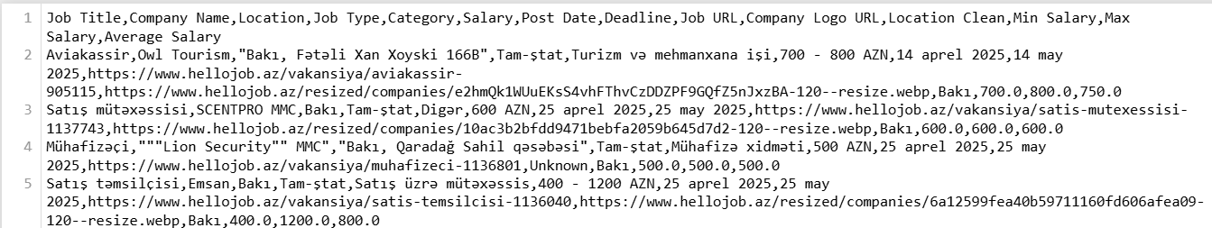
EDA & Preprocessing
Missing Values, Duplicates, Raw and Column Size Analysis, Data Type Conversion, isNull(), df.info()…

Slide 8
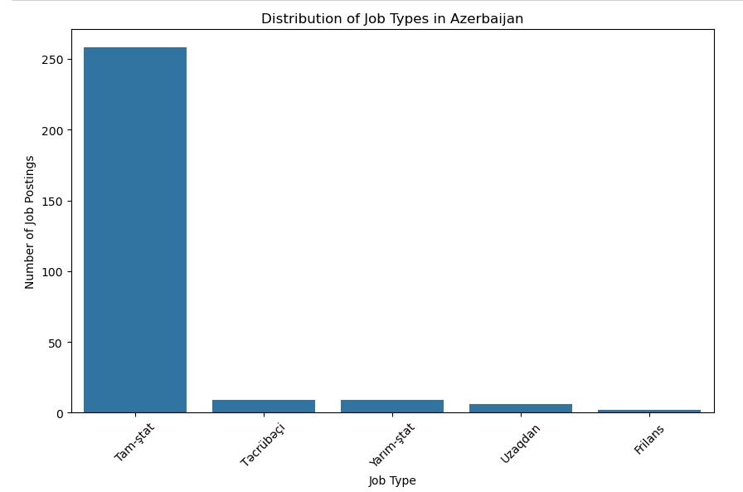
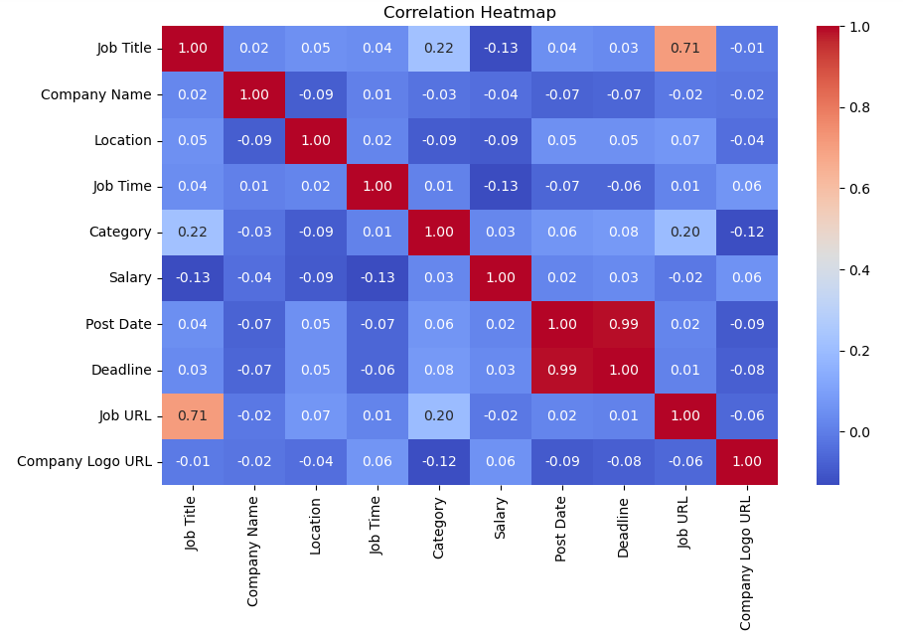
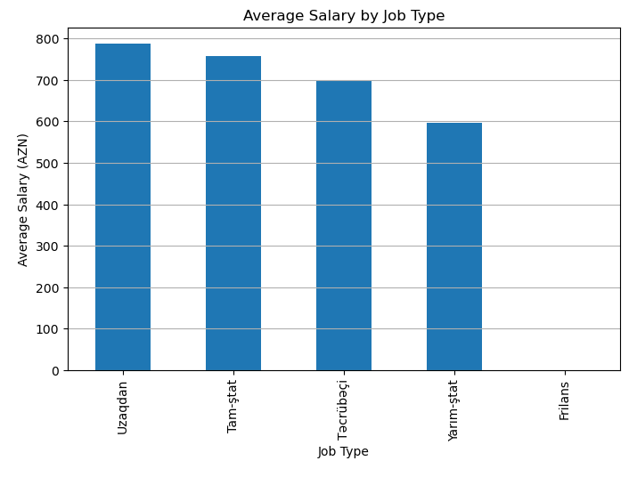
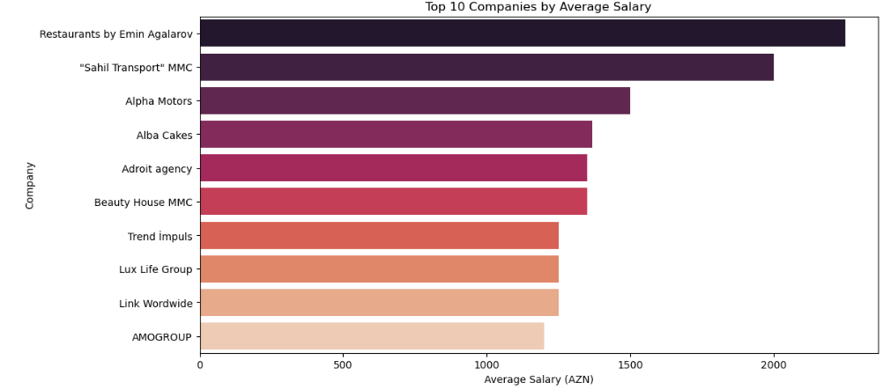
Results & Visuals

Slide 9
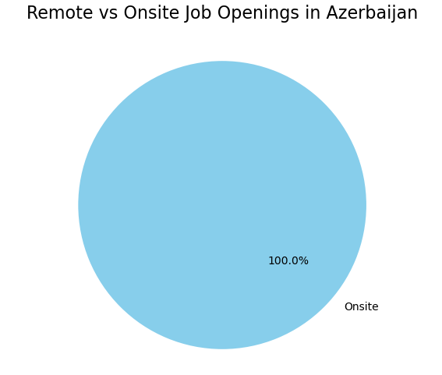
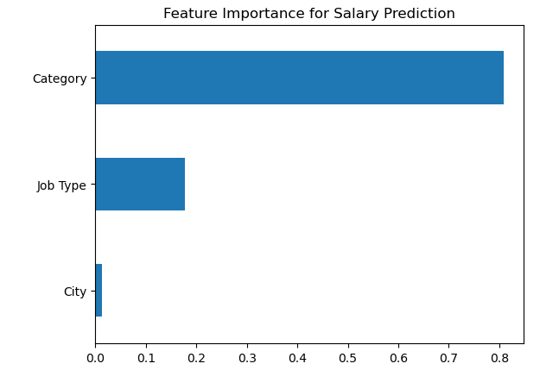
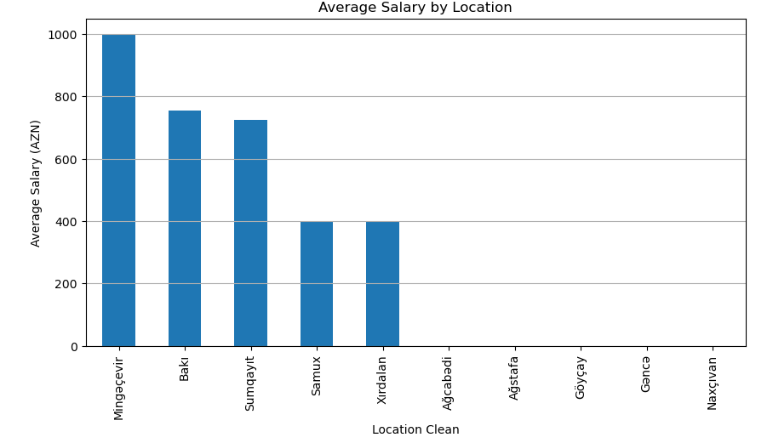
Results & Visuals

Slide 10
Machine Learning Tasks
# Question 1. Can we predict the salary (average salary) based on the job type, category, and city? (Regression)
# Question 2. Can we classify the job type (full-time, part-time, etc.) based on salary, category, and city? (Classification)
# Question 3. Which features most strongly influence whether a job has a higher salary (>800 AZN)? (Binary classification (high vs low salary))
# Question 4. Can we predict how many days it takes for a job posting to close (deadline-post date)? (Regression (time prediction))
# Question 5. Based on location, can we predict if a job is remote or onsite? (Binary classification)

Slide 11
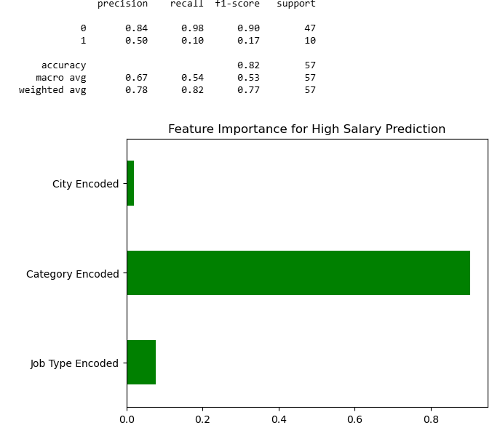
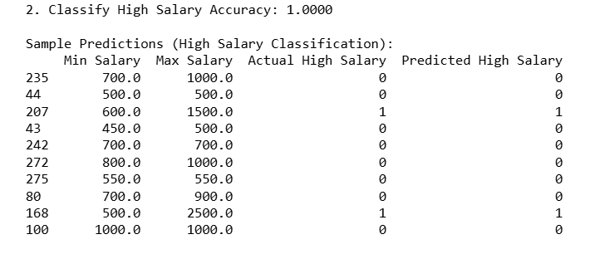
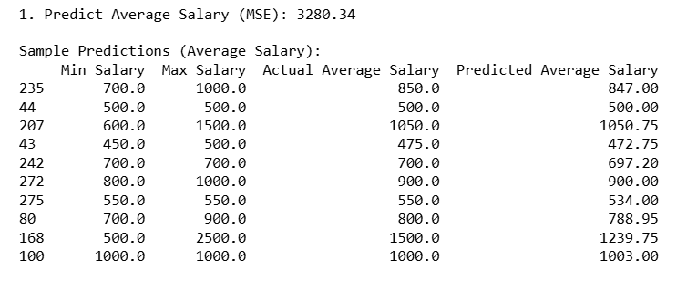
Machine Learning Tasks

Slide 12
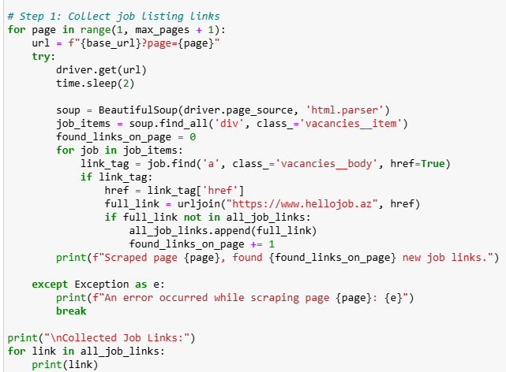
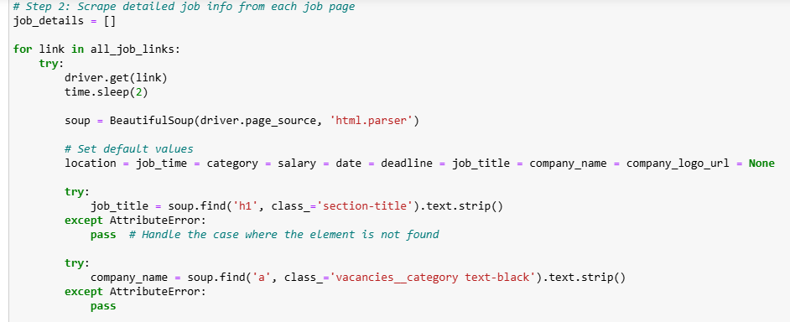
Code Demonstration

Slide 13
References
https://www.hellojob.az/
https://www.geeksforgeeks.org/what-is-web-scraping-and-how-to-use-it/
https://www.youtube.com/watch?v=8dTpNajxaH0&t=1s
https://www.youtube.com/watch?v=PPcgtx0sI2E

Slide 14
THANK YOU FOR YOUR ATTENTION!
Questions?

